Slide 1
Fashion Store Analysis
Presented by: Anjali K.
Last Updated : 6th July 2025

Slide 2
Objective :
Despite growing sales, a fashion e-commerce platform faces declining profitability . To develop data-driven strategies to reduce costs and increase profits.

Slide 3
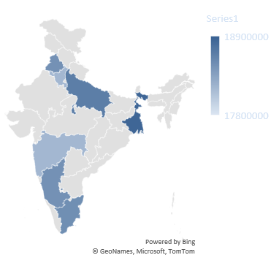
Data Overview:
The store operates across seven major states in India, namely: Haryana, Karnataka, Maharashtra, Punjab, Tamil Nadu, Uttar Pradesh, and West Bengal.
The store operates through six major online sales channels, including: Ajio, Amazon, Flipkart, Meesho, Myntra, and Nykaa.
The data has been analyzed for one year, from April 2024 to April 2025, covering the store’s operations since it opened. This analysis provides key insights into its performance in the first year.

Slide 4
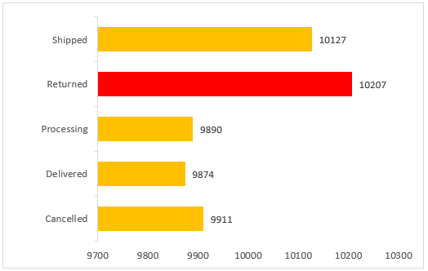
The returned orders (red) stand out and are a serious concern — more orders are being returned than successfully delivered.
Both returned + cancelled = undelivered orders are dragging down profitability.
High Shipped but Low Delivered: Indicates inefficiency in the logistics or customer non-acceptance at delivery.
Audit returned orders for common reasons — incorrect sizes, damaged goods, misleading descriptions.
Notes:
High Shipped but Low Delivered: Shipped orders (10,127) exceed delivered (9,874), which means ~250 orders are stuck in transit, returned-to-origin (RTO), or undelivered.
Choose Reliable Delivery Partners
-Partner with well-rated --logistics providers that specialize in your regions.
-Let customers choose between standard, express, or scheduled delivery slots — improves convenience and reduces refusal-at-door.
About 9,890 orders are still marked as Processing fulfillment times might be slow. Stock popular products closer to high-demand regions to reduce shipping time.

Slide 5
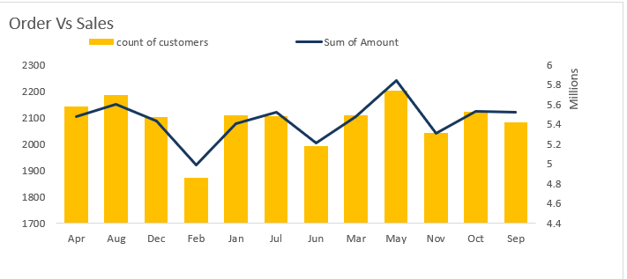
May shows the highest sales (sum of amount) and also a high customer count — due to a seasonal campaign and end-of-season summer sale.
February and June show dips in customer count and sales — these months need additional marketing efforts.
The number of customers (yellow bars) is fairly stable between ~1900–2200 across months

Slide 6
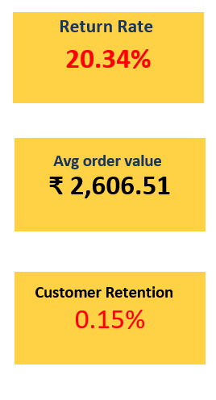
High return rate and negligible retention are eroding profitability despite a good AOV.
Extremely Low Customer Retention. Customer relationships and loyalty are still developing as the business is newly launched.
Launch loyalty and rewards programs — offer points and discounts for repeat purchases.
Improve after-sales support — quick responses, easy exchanges, and friendly service build trust and emotional connection.
Notes:
Absence of structured loyalty programs or consistent follow-up limits repeat engagement.
Limited emotional connection with the brand and low brand recall among customers.
Collect and act on customer feedback — show customers their opinions matter.
Stay in touch with email, SMS, or WhatsApp campaigns — keep the brand top-of-mind.
**Surprise customers with exclusive previews, birthday offers, or freebies.
*** Build a community around the brand — engage via social media, contests, and content.

Slide 7
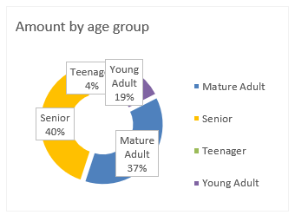
The majority of sales (77%) come from Senior(50+) and Mature Adult(30-50) age groups — these should be the primary target audiences.
Young Adults contribute only 19%. Product assortment is not aligned with trends or preferences of younger audiences.
Price points may be too high for these segments.
Opportunity: we can introduce more trend-driven, affordable to attract younger demographics.

Slide 8
CONCLUSION

Slide 9
Conclusion
1
2
3
The store suffers from a high return rate and very low customer retention, which offset the benefits of good sales and average order value
Most sales come from Senior (50+) and Mature Adult (30–50) customers and from certain regions.
High shipped but low delivered orders indicate inefficiencies in delivery and customer acceptance.
Notes:
---Improving product quality, descriptions, and introducing loyalty programs are essential.
--Marketing efforts and inventory planning should prioritize these profitable segments while also exploring opportunities with younger audiences through trend-driven, affordable products.
--Strengthening logistics, after-sales support, and proactive customer engagement will reduce cancellations and improve satisfaction.

Slide 10
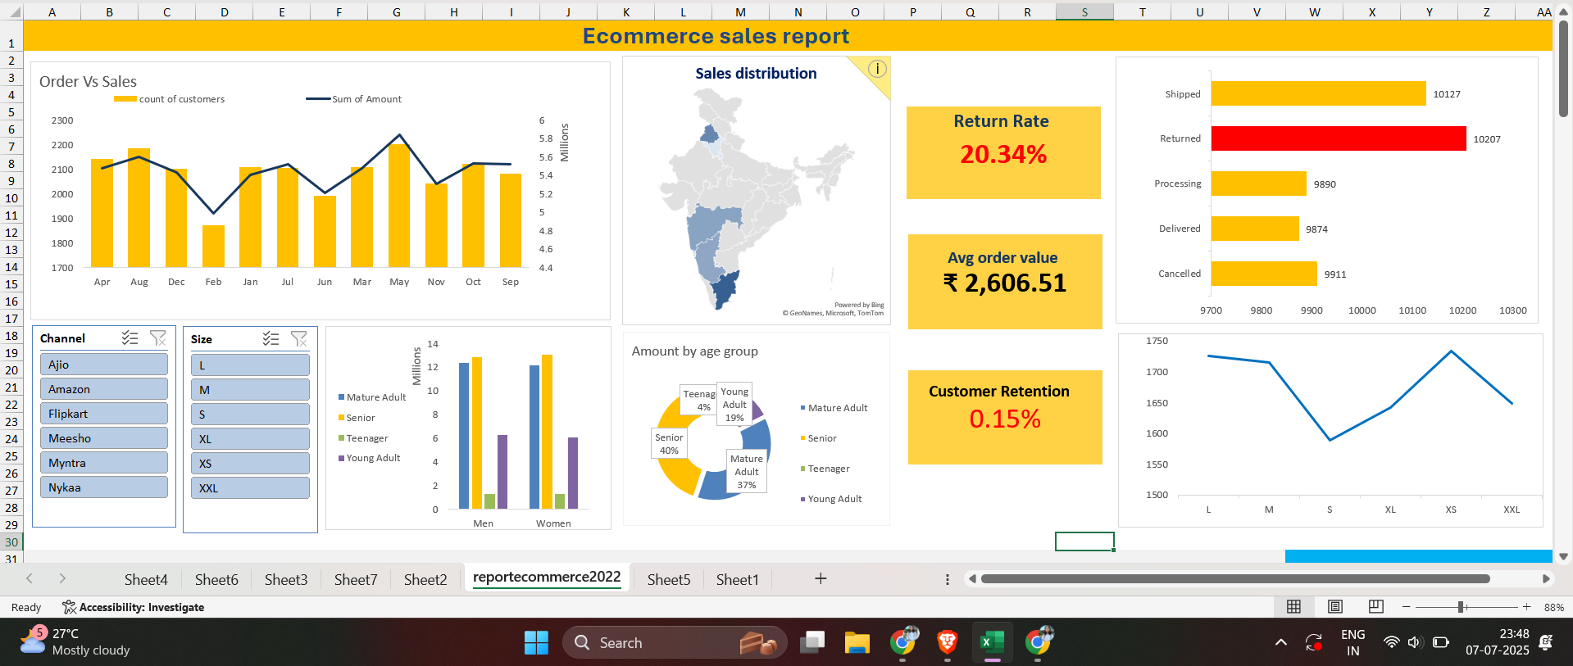
DASHBOARD
Created on : 13 April 2025
Created by: Anjali K.

Slide 11
Appendix:
High Returns & Low Retention Hurt Profitability: The store suffers from a high return rate and very low customer retention, which offset the benefits of good sales and average order value. Improving product quality, descriptions, and introducing loyalty programs are essential.
Focus on Key Demographics & Regions: Most sales come from Senior (50+) and Mature Adult (30–50) customers and from certain regions. Marketing efforts and inventory planning should prioritize these profitable segments while also exploring opportunities with younger audiences through trend-driven, affordable products.
Logistics & Customer Experience Need Improvement: High shipped but low delivered orders indicate inefficiencies in delivery and customer acceptance. Strengthening logistics, after-sales support, and proactive customer engagement will reduce cancellations and improve satisfaction.

Slide 12
Scope for further analysis :
Are returns concentrated on specific products, categories, sizes, or customer segments?
Are there specific products or categories we should discontinue or promote?

